Slide 1
Distributed and Cloud Operating System
Sushant Paudel

Slide 2
Sushant Paudel
5+ years in full-stack development, 3+ years in Web3 (Solana & Polygon).
Expertise in Node.js, ReactJS, and Web Technologies
Worked with companies like Proshore Nepal, General Technology, and Aankhijhyal Technologies.
Expertise in AWS services, database performance tuning, and scalable architectures.

Slide 3
Outline
Key concepts in Distributed Operating System Architecture (Transparency, Communication, Synchronization)
Cloud OS: Kubernetes, OpenStack
Fault Tolerance and Load balancing in distributed systems: Concepts, types, techniques and algorithms
Resource Management in Cloud Environments
Case studies: Amazon DynamoDB (NoSQL), Microsoft Azure and Fault Tolerant DS

Slide 4
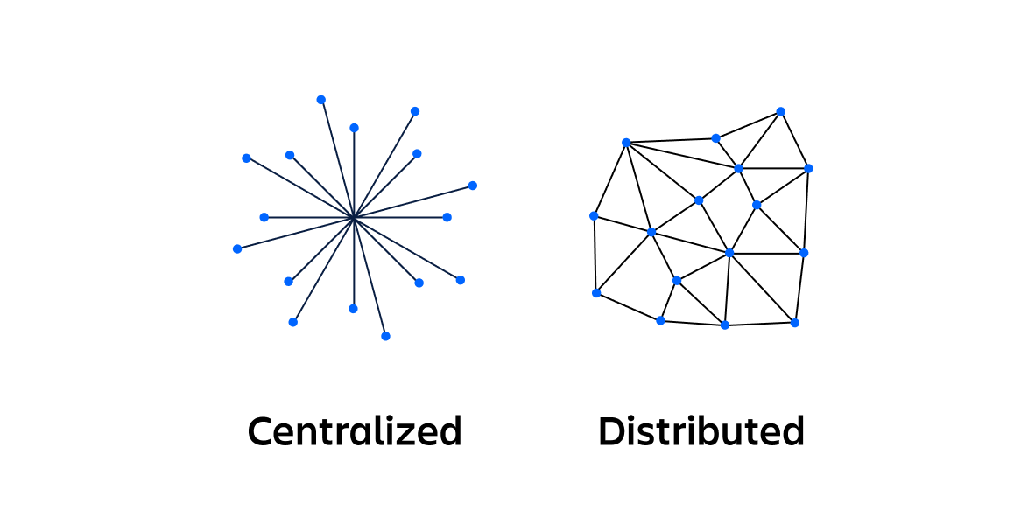

Slide 5
Distributed System
A distributed system is a collection of computer programs that utilize computational resources across multiple, separate computation nodes to achieve a common, shared goal.
Distributed systems aim to remove bottlenecks or central points of failure from a system.
Also known as distributed computing or distributed databases, it relies on separate nodes to communicate and synchronize over a common network.
These nodes typically represent separate physical hardware devices but can also represent separate software processes, or other recursive encapsulated systems.

Slide 6
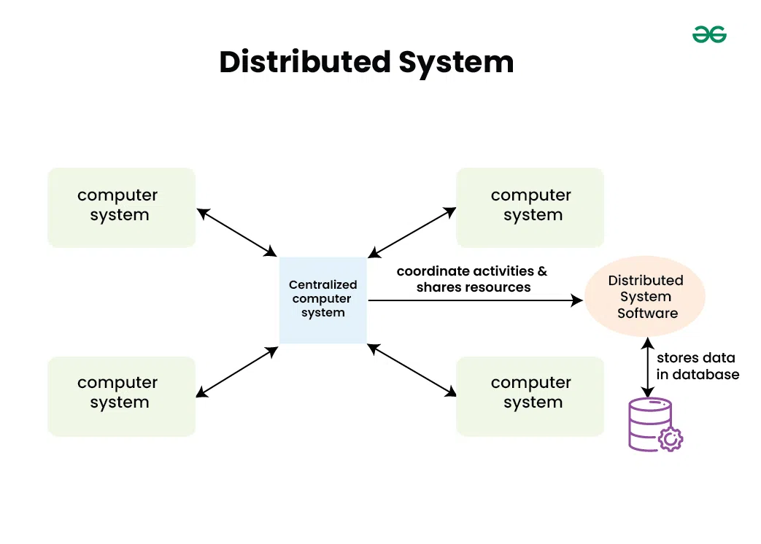

Slide 7
Characteristics of Distributed System
Resource sharing – A distributed system can share hardware, software, or data
Simultaneous processing – Multiple machines can process the same function simultaneously
Scalability – The computing and processing capacity can scale up as needed when extended to additional machines
Error detection – Failures can be more easily detected
Transparency – A node can access and communicate with other nodes in the system

Slide 8
Examples of distributed systems
Telecommunications networks that support mobile and internet networks
Graphical and video-rendering systems
Scientific computing, such as protein folding and genetic research
Airline and hotel reservation systems
Multiuser video conferencing systems
Cryptocurrency processing systems (e.g. Bitcoin)
Peer-to-peer file-sharing systems
Distributed community computing systems
Multiplayer video games
Global, distributed retailers and supply chain management

Slide 9
Not always distributed!!!
Tradeoff to these benefits can be “development sprawl”, where a system becomes overly complex and maintenance becomes challenging.
As a system grows in complexity, teams may struggle to effectively organize, manage, and improve these systems.
Part of the issue can be understanding how different components relate to each other or who owns a particular software component.

Slide 10
Not always distributed!!!
This makes it hard to understand how to make changes to components in ways that maximize operational health and avoid causing negative impact to not just dependent components, but customers.
When a system has multiple repositories, specialized tools may be required to manage and organize the code of a distributed system

Slide 11
Architectures of distributed systems
Client-server
Multi-tier
Peer-to-peer
Service-oriented architecture

Slide 12
Client-server
A client-server architecture is broken down into two primary responsibilities.
The client is responsible for the user interface presentation, which then connects over the network to the server.
The server is responsible for handling business logic and state management.
A client-server architecture can easily degrade into a centralized architecture if the server is not made redundant.
A truly distributed client-server setup will have multiple server nodes to distribute client connections.
Most modern client-server architectures are clients that connect to an encapsulated distributed system on the server.

Slide 13
Multi-tier
A multi-tier architecture expands on the client-server architecture.
The server in a multi-tier architecture is decomposed into further granular nodes, which decouple additional backend server responsibilities like data processing and data management.
These additional nodes are used to asynchronously process long-running jobs and free up the remaining backend nodes to focus on responding to client requests, and interfacing with the data store.

Slide 14
Peer-to-peer
In a peer-to-peer distributed system, each node contains the full instance of an application.
There is no node separation of presentation and data processing.
A node contains the presentation layer and data handling layers.
The peer nodes may contain the entire state data of the entire system.
Peer-to-peer systems have the benefit of extreme redundancy

Slide 15
Service-oriented architecture
Service-oriented architecture (SOA) is a predecessor of microservices.
The main difference between SOA and microservices is node scope – the scope of microservice nodes exist at the feature level.
In microservices a node encapsulates the business logic to handle a specific feature set, such as payment processing.
Microservices contain multiple disparate business logic nodes that interface with independent database nodes.
Comparatively, SOA nodes encapsulate an entire application or enterprise division.
The service boundary for SOA nodes typically includes an entire database system within the node.

Slide 16
Cloud Operating System
The cloud OS is a browser-based operating system that works for real-time support.
It is developed for visualization in cloud computing.
It provides a virtualized environment that runs on cloud computing.
It helps to manage the machines, processes of virtual servers, execution, and infrastructure.
It also manages software and back-end hardware resources.

Slide 17
Cloud Operating System
Although, the features of the cloud OS differs depending on the virtual environment and cloud services used. It is a lightweight OS that stores data and connects to a remote server to access web-based apps. Cloud OS include Google Chrome operating system and Microsoft Windows Azure.
The Cloud Operating System is OS that used to data store assessing a web-based application from a remote server also used as hardware and software resources.
The Cloud OS is designed to operate, execute, and manage the application such as pdf reader, address book, word processer and many more to determines users’ response to it.

Slide 18
Cloud Operating system
Cloud Operating System operates virtual machines within the virtualized environment functions of the operating system are varies.
Cloud OS is used in computing specific environment, users need to preinstalled applications and services can able to assess through web browsers.

Slide 19
Distributed cloud operating system
A distributed cloud is an architecture where multiple clouds are used to meet compliance needs, performance requirements, or support edge computing while being centrally managed from the public cloud provider.
In essence, a distributed cloud service is a public cloud that runs in multiple locations, including
  The public cloud provider’s infrastructure
  On-premises at end customer locations in the data center or at the edge
  In another cloud provider’s data center
  On third party or colocation center hardware

Slide 20
Distributed cloud operating system
DC/OS (the Distributed Cloud Operating System) is an open-source, distributed operating system based on the Apache Mesos distributed systems kernel.
DC/OS manages multiple machines in the cloud or on-premises from a single interface; deploys containers, distributed services, and legacy applications into those machines; and provides networking, service discovery and resource management to keep the services running and communicating with each other.

Slide 21
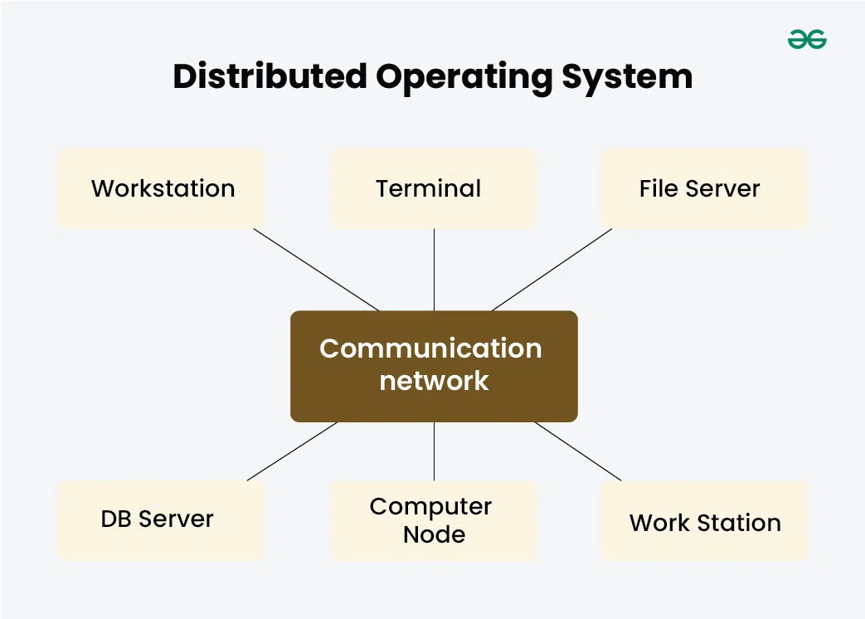

Slide 22
Key concepts in distributed operating system architecture
A DOS is a system which contains multiple components located on different machines, which coordinate and communicate actions in order to appear as a single coherent working system to the user.
A distributed operating system (DOS), are systems which model where distributed applications are running on multiple computers, linked by communications.
Processors in a DOS communicate with each other through various communication lines like high-speed buses.

Slide 23
Transparency
Transparency or single-system image refers to the ability of an application to treat the system on which it operates without regard to whether it is distributed and without regard to hardware or other implementation details.
Many areas of a system can benefit from transparency, including access, location, performance, naming, and migration.
The consideration of transparency directly affects decision making in every aspect of design of a distributed operating system.
Transparency can impose certain requirements and/or restrictions on other design considerations.

Slide 24
Transparency
DOS are perceived by programmers and users as a whole system, rather than a collection of cooperating components. Thus meaning the communication between components is hidden.
Transparency is the most important feature of the distributed operating system
Transparency also implies that the user should be unaware that the resources he is accessing are shared

Slide 25
Types of transparency linked with DOS
Access Transparency – Hides differences in data representation and access mechanisms, allowing users to interact with resources uniformly.
Location Transparency – Users and applications can access resources without knowing their physical or network location.
Migration Transparency – Ensures that resources or processes can move between nodes without impacting operations or user experience.

Slide 26
Types of transparency linked with DOS
Concurrency Transparency – Allows multiple processes to execute simultaneously on shared resources without conflicts.
Replication Transparency – Hides the presence of multiple copies of resources to improve reliability and performance.
Failure Transparency – Ensures that failures in hardware, software, or network components do not disrupt operations.

Slide 27
Types of transparency linked with DOS
Mobility Transparency – Allows users, applications, and services to move across different devices and networks seamlessly.
Performance Transparency – Optimizes resource utilization to maintain consistent performance under varying loads.
Scaling Transparency – Enables systems to expand or contract dynamically without requiring user intervention.
Revision Transparency – Ensures software and system updates do not impact ongoing operations or user experiences.

Slide 28
Types of transparency linked with DOS
Control Transparency – Hides administrative and management complexities from end-users while maintaining security and compliance.
Data Transparency – Allows data access and management without revealing underlying storage mechanisms or formats.
Parallelism Transparency – Hides complexities of parallel execution, allowing applications to benefit from distributed computing without modification.

Slide 29
Communication
Inter-Process Communication (IPC) is the implementation of general communication, process interaction, and dataflow between threads and/or processes both within a node, and between nodes in a distributed OS.
The intra-node and inter-node communication requirements drive low-level IPC design, which is the typical approach to implementing communication functions that support transparency.
In this sense, Inter-process communication is the greatest underlying concept in the low-level design considerations of a distributed operating system

Slide 30
Synchronization
Cooperating concurrent processes have an inherent need for synchronization, which ensures that changes happen in a correct and predictable fashion. Three basic situations that define the scope of this need:
  one or more processes must synchronize at a given point for one or more other processes to continue,
  one or more processes must wait for an asynchronous condition in order to continue,
  or a process must establish exclusive access to a shared resource.
Improper synchronization can lead to multiple failure modes including loss of atomicity, consistency, isolation and durability, deadlock, livelock and loss of serializability.

Slide 31
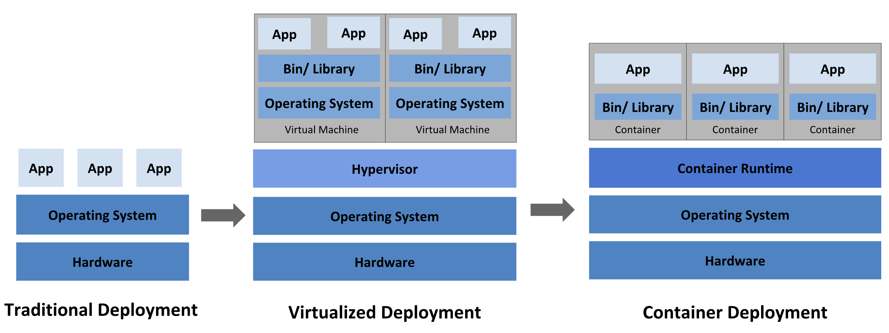

Slide 32
Cloud OS: Kubernetes, OpenStack
OpenStack and Kubernetes are powerful and feature-rich open-source technologies that play an important role in cloud computing.
OpenStack is a highly customizable cloud platform designed to be deployed on a wide range of hardware. It lets you build your own private cloud by providing a full suite of services for compute, storage, and networking.

Slide 33
Cloud OS: Kubernetes, OpenStack
Kubernetes (K8s) is a container orchestration platform that automates containerized applications’ deployment, scaling, and management. Originally developed by Google, K8s has become a standard for container orchestration. The platform can be deployed on various platforms, including bare metal and cloud infrastructure, and enables developers to manage complex applications efficiently across clusters of machines.

Slide 34
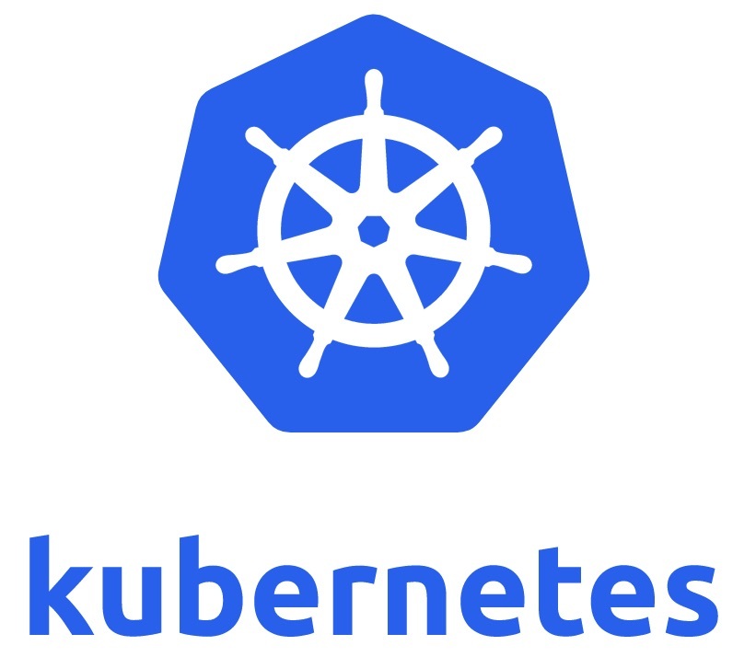

Slide 35
Kubernetes
Kubernetes is a portable, extensible, open source platform for managing containerized workloads and services, that facilitates both declarative configuration and automation.
It has a large, rapidly growing ecosystem.
Kubernetes services, support, and tools are widely available.

Slide 36
Why you need Kubernetes and what it can do
Containers are a good way to bundle and run your applications.
In a production environment, you need to manage the containers that run the applications and ensure that there is no downtime.
For example, if a container goes down, another container needs to start. Wouldn't it be easier if this behavior was handled by a system?

Slide 37
Why you need Kubernetes and what it can do
That's how Kubernetes comes to the rescue! Kubernetes provides you with a framework to run distributed systems resiliently.
It takes care of scaling and failover for your application, provides deployment patterns, and more.
For example: Kubernetes can easily manage a canary deployment for your system.

Slide 38
Kubernetes provides
Service discovery and load balancing Kubernetes can expose a container using the DNS name or using their own IP address. If traffic to a container is high, Kubernetes is able to load balance and distribute the network traffic so that the deployment is stable.
Storage orchestration Kubernetes allows you to automatically mount a storage system of your choice, such as local storages, public cloud providers, and more.
Automated rollouts and rollbacks You can describe the desired state for your deployed containers using Kubernetes, and it can change the actual state to the desired state at a controlled rate. For example, you can automate Kubernetes to create new containers for your deployment, remove existing containers and adopt all their resources to the new container.

Slide 39
Kubernetes provides
Automatic bin packing You provide Kubernetes with a cluster of nodes that it can use to run containerized tasks. You tell Kubernetes how much CPU and memory (RAM) each container needs. Kubernetes can fit containers onto your nodes to make the best use of your resources.
Self-healing Kubernetes restarts containers that fail, replaces containers, kills containers that don't respond to your user-defined health check, and doesn't advertise them to clients until they are ready to serve.

Slide 40
Kubernetes provides
Secret and configuration management Kubernetes lets you store and manage sensitive information, such as passwords, OAuth tokens, and SSH keys. You can deploy and update secrets and application configuration without rebuilding your container images, and without exposing secrets in your stack configuration.
Batch execution In addition to services, Kubernetes can manage your batch and CI workloads, replacing containers that fail, if desired.

Slide 41
Kubernetes provides
Horizontal scaling Scale your application up and down with a simple command, with a UI, or automatically based on CPU usage.
IPv4/IPv6 dual-stack Allocation of IPv4 and IPv6 addresses to Pods and Services
Designed for extensibility Add features to your Kubernetes cluster without changing upstream source code

Slide 42
What Kubernetes is not
Kubernetes is not a traditional, all-inclusive PaaS (Platform as a Service) system.
Since Kubernetes operates at the container level rather than at the hardware level, it provides some generally applicable features common to PaaS offerings, such as deployment, scaling, load balancing, and lets users integrate their logging, monitoring, and alerting solutions.
However, Kubernetes is not monolithic, and these default solutions are optional and pluggable.
Kubernetes provides the building blocks for building developer platforms, but preserves user choice and flexibility where it is important.

Slide 43
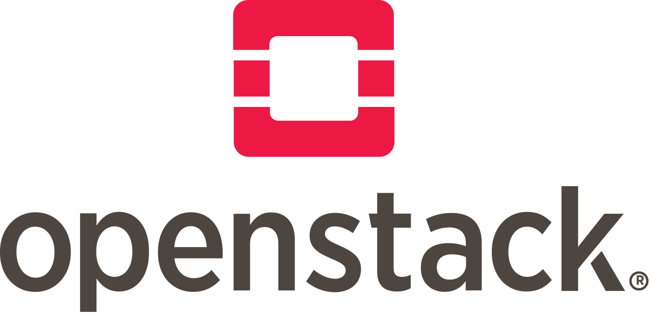

Slide 44
OpenStack
OpenStack is a free, open standard cloud computing platform.
It is mostly deployed as infrastructure-as-a-service (IaaS) in both public and private clouds where virtual servers and other resources are made available to users.
The software platform consists of interrelated components that control diverse, multi-vendor hardware pools of processing, storage, and networking resources throughout a data center.
Users manage it either through a web-based dashboard, through command-line tools, or through RESTful web services.

Slide 45
OpenStack
OpenStack is an open source platform that uses pooled virtual resources to build and manage private and public clouds.
The tools that comprise the OpenStack platform, called "projects," handle the core cloud-computing services of compute, networking, storage, identity, and image services.
More than a dozen optional projects can also be bundled together to create unique, deployable clouds.

Slide 46
OpenStack
In virtualization, resources such as storage, CPU, and RAM are abstracted from a variety of vendor-specific programs and split by a hypervisor before being distributed as needed.
OpenStack uses a consistent set of application programming interfaces (APIs) to abstract those virtual resources 1 step further into discrete pools used to power standard cloud computing tools that administrators and users interact with directly.

Slide 47
OpenStack
OpenStack is essentially a series of commands known as scripts. Those scripts are bundled into packages called projects that relay tasks that create cloud environments.
In order to create those environments, OpenStack relies on 2 other types of software:
  Virtualization that creates a layer of virtual resources abstracted from hardware
  A base operating system (OS) that carries out commands given by OpenStack scripts.

Slide 48
Fault Tolerance and Load balancing in distributed systems: Concepts, types, techniques and algorithms

Slide 49
Fault tolerance
Fault tolerance, in the realm of distributed systems, refers to the ability of a system to continue operating without interruption despite encountering failures or faults in one or more of its components.
It is a measure of the system's resilience against disruptions (ranging from a single server failure to a whole data center outage due to power failure) and its capability to ensure consistent and reliable performance.

Slide 50
Fault tolerance
Fault Tolerance is defined as the ability of the system to function properly even in the presence of any failure.
Distributed systems consist of multiple components due to which there is a high risk of faults occurring.
Due to the presence of faults, the overall performance may degrade.

Slide 51
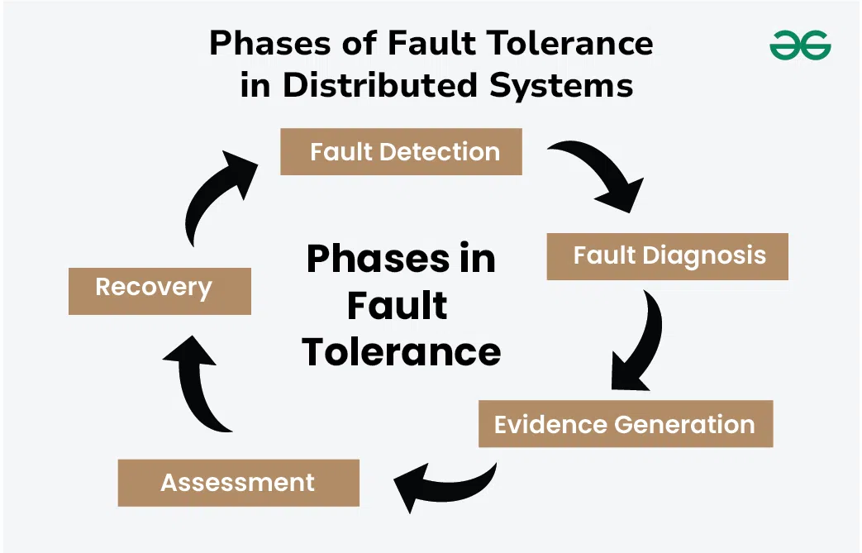
Fault Tolerance Techniques
In order to implement the techniques for fault tolerance in distributed systems, the design, configuration and relevant applications need to be considered.
Here are the phases carried out for fault tolerance in any distributed systems

Slide 52
Phases of Fault Tolerance
Fault Detection
Fault Detection is the first phase where the system is monitored continuously.
The outcomes are being compared with the expected output.
During monitoring if any faults are identified they are being notified.
These faults can occur due to various reasons such as hardware failure, network failure, and software issues.
The main aim of the first phase is to detect these faults as soon as they occur so that the work being assigned will not be delayed.

Slide 53
Phases of Fault Tolerance
Fault Diagnosis
Fault diagnosis is the process where the fault that is identified in the first phase will be diagnosed properly in order to get the root cause and possible nature of the faults.
Fault diagnosis can be done manually by the administrator or by using automated Techniques in order to solve the fault and perform the given task.

Slide 54
Phases of Fault Tolerance
Evidence Generation
Evidence generation is defined as the process where the report of the fault is prepared based on the diagnosis done in an earlier phase.
This report involves the details of the causes of the fault, the nature of faults, the solutions that can be used for fixing, and other alternatives and preventions that need to be considered

Slide 55
Phases of Fault Tolerance
Assessment
Assessment is the process where the damages caused by the faults are analyzed.
It can be determined with the help of messages that are being passed from the component that has encountered the fault. Based on the assessment further decisions are made.

Slide 56
Phases of Fault Tolerance
Recovery
Recovery is the process where the aim is to make the system fault free.
It is the step to make the system fault free and restore it to state forward recovery and backup recovery.
Some of the common recovery techniques such as reconfiguration and resynchronization can be used.

Slide 57
Types of Fault Tolerance in Distributed Systems
Hardware Fault Tolerance: Hardware Fault Tolerance involves keeping a backup plan for hardware devices such as memory, hard disk, CPU, and other hardware peripheral devices. Hardware Fault Tolerance is a type of fault tolerance that does not examine faults and runtime errors but can only provide hardware backup. The two different approaches that are used in Hardware Fault Tolerance are fault-masking and dynamic recovery.

Slide 58
Types of Fault Tolerance in Distributed Systems
Software Fault Tolerance: Software Fault Tolerance is a type of fault tolerance where dedicated software is used in order to detect invalid output, runtime, and programming errors. Software Fault Tolerance makes use of static and dynamic methods for detecting and providing the solution. Software Fault Tolerance also consists of additional data points such as recovery rollback and checkpoints.

Slide 59
Types of Fault Tolerance in Distributed Systems
System Fault Tolerance: System Fault Tolerance is a type of fault tolerance that consists of a whole system. It has the advantage that it not only stores the checkpoints but also the memory block, and program checkpoints and detects the errors in applications automatically. If the system encounters any type of fault or error it does provide the required mechanism for the solution. Thus system fault tolerance is reliable and efficient.

Slide 60
Load balancing
Load balancing is a technique that distributes incoming traffic or requests evenly across multiple nodes.
This not only improves performance but also enhances fault tolerance.
If one node becomes overwhelmed or fails, the load balancer can redirect traffic to healthy nodes, preventing overloads and downtime

Slide 61
Load balancing algorithms
Static
  Round Robin
  Weightet Round Robin
  Source IP hash
Dynamic
  Least connection method
  Least response time method

Slide 62
Resource management in cloud environments
In cloud computing, resource management refers to the process of managing the usage of resources in a cloud environment.
This includes compute resources (like CPU and memory), storage resources (like disk space), and network resources (like bandwidth).
Resource management is crucial for optimizing the performance and cost of a cloud environment.
It involves monitoring resource usage, allocating resources, and managing resource capacity.

Slide 63
Types of Resources
Physical Resource: Computer, disk, database, network, etc.
Logical Resource: Execution, monitoring, and application to communicate

Slide 64
Resource Management in Cloud Computing Environment
On the Cloud Vendor’s View
  Provision resources on an on-demand basis.
  Energy conservation and proper utilization is maintained in Cloud Data Centers
On the Cloud Service Provider’s View
  To make available the best performance resources at the cheapest cost.
  QoS (Quality of Service) to their cloud users
On the Cloud User’s View
  Renting resources at a low price without compromising performance
  Cloud provider guarantees to provide a minimum level of service to the user

Slide 65
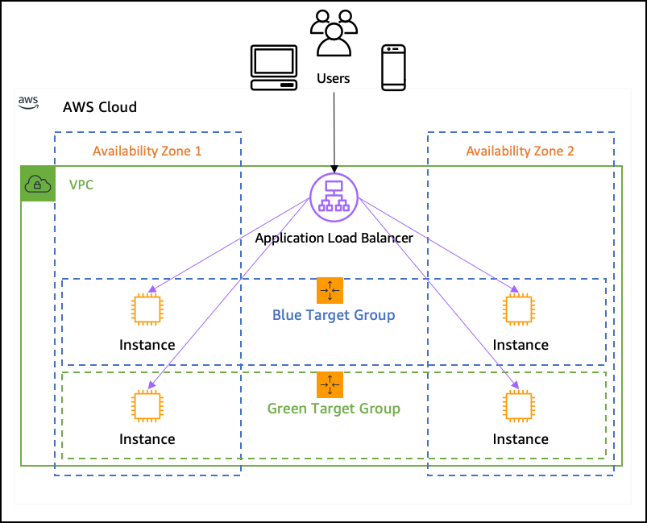
AWS

Slide 66
THANK YOU

